Slide 1
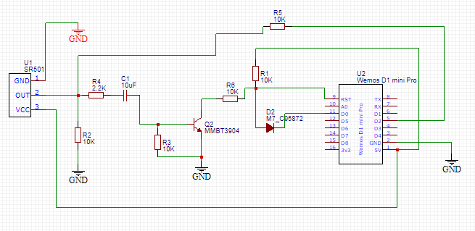
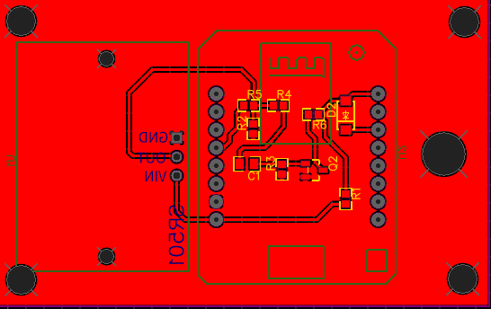
PCB REDESIGNED WITH DEEP SLEEP CIRCUIT INCORPORATED

Slide 2
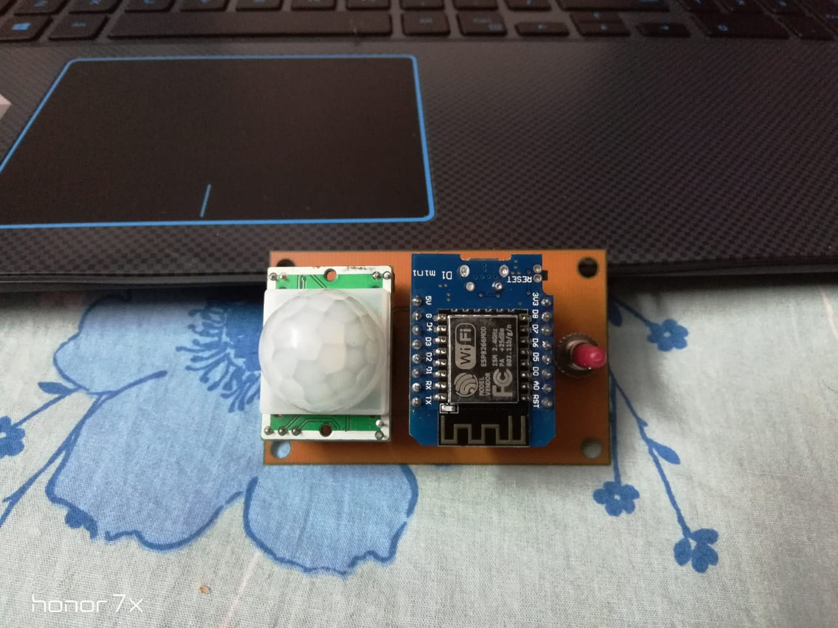
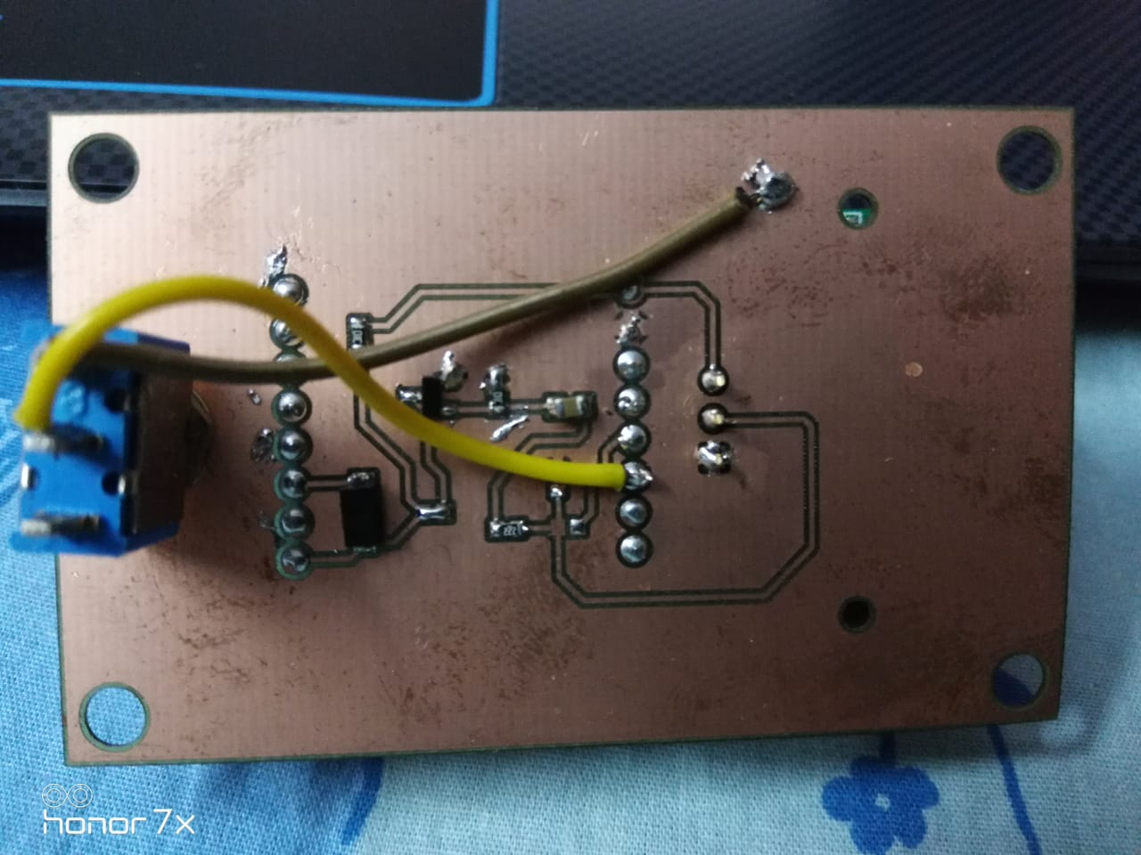

Slide 3

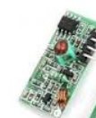
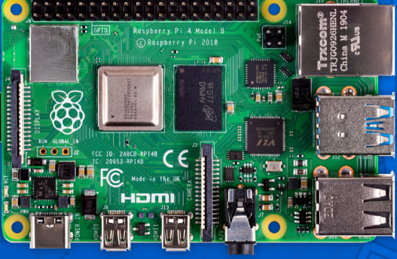
ALTERNATE PROPOSED PLAN FOR BATTERY POWERED SETUP AND POWER CONSUMPTION
RF Module
PIR sensor
RF Module Transmitter
RF Module Receiver
An RF module (radio frequency module) is a (usually) small electronic device used to transmit and/or receive radio signals between two devices. In an embedded system it is often desirable to communicate with another device wirelessly. This wireless communication may be accomplished through optical communication or through radio frequency (RF) communication. For many applications the medium of choice is RF since it does not require line of sight. RF communications incorporate a transmitter and a receiver.
Status : Still working

Slide 4
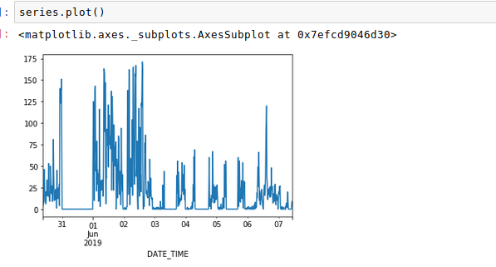
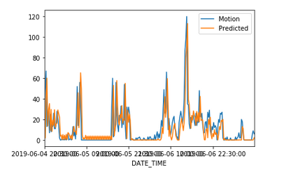

LSTM WITH UNIVARIANT TIME FORECASTING
DATA
PREDICTION
The RMSE score has been improved to 12 now with appropriate optimizations in LSTM.

Slide 5
UPCOMING TASKS
Design of Alternate RF setup powered with Battery.
Battery health status publication from the ESP end.
Usage of Trained model to predict real time fed series of motion values
Anomaly detection based on predcited and real time results.
Integration and Visualization with Influx DB.

